Slide 1

Reward modulates cortical representations of action
Tyler Adkins
University of Michigan
Department of Psychology
Cognition & Cognitive Neuroscience Area

Slide 2
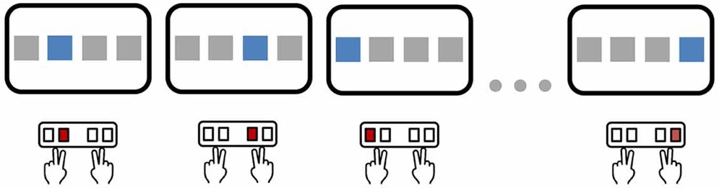
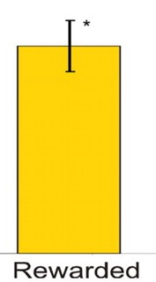
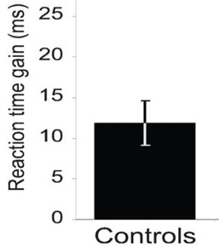
Background
People perform actions more quickly and accurately when rewarded.
Wächter et al., JNeuro., 2009.

Slide 3
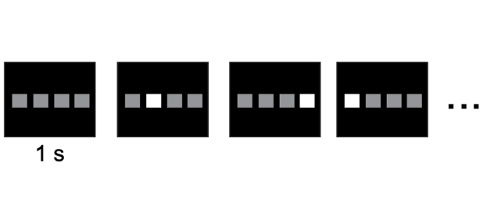
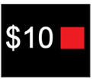
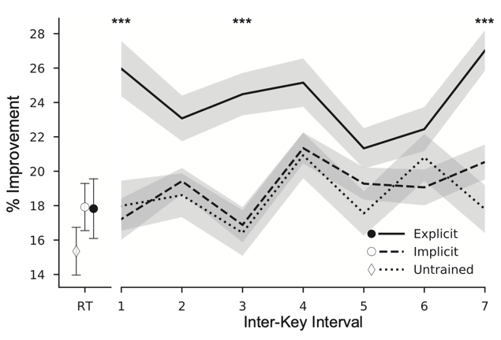
Background
Reward-related improvements are greater when people can prepare their actions.
Cued
% Improvement from reward
Not cued
Movement
Anderson et al., JNeuroPhys., 2020.

Slide 4
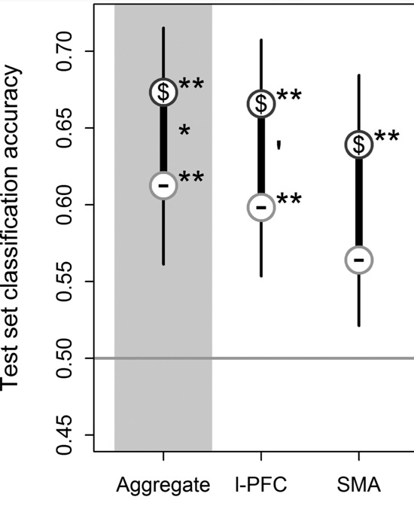
Background
Reward enhances task coding during preparation.
Etzel, et al. Cerebral cortex, 2015

Slide 5
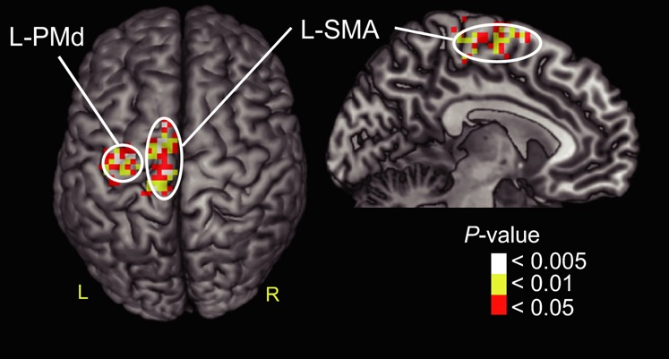
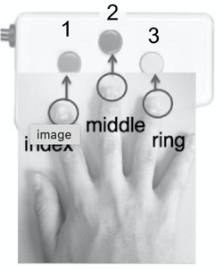
Background
Motor sequences can be decoded from brain activity during preparation.
Nambu et al., Euro.JNeuro, 2015.

Slide 6
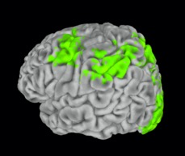
Question
Does reward enhance action by modulating action coding during preparation?

Slide 7
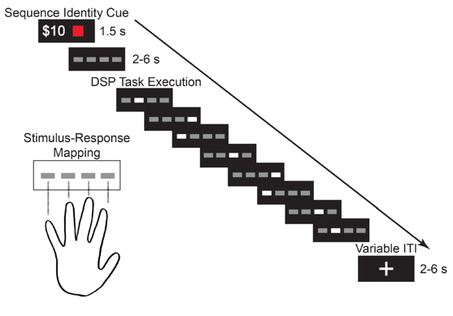
Experiment
Participants performed motor sequences for reward ($5, $10, or $30).
fMRI analyses focused on cue-related activity.

Slide 8
Reward-modulated behavior
Movement speed and accuracy improved with reward value.
*
*
Accuracy
* pd > 95%

Slide 9
Reward-modulated areas
Univariate activity during preparation increased with reward value.

Slide 10
Action information map
Distributed multivariate activity during preparation predicted upcoming action…
*
* p < .05

Slide 11
Performance information map
…and upcoming success/failure.
*
* p < .05

Slide 12
ROI analyses
Action decoding accuracy was higher on high reward trials…
*
*
†
* p < .05 with permutation testing
† p = .06

Slide 13
ROI analyses
…and action decoding coincided with improved behavior.
*
* pd > 95%

Slide 14
Conclusions
Reward enhanced the speed and accuracy of action.
During movement preparation, many brain areas were modulated by reward.
Some of these areas contained information about the target action and the quality of performance.
Action decoding in motor planning areas was more accurate for high reward trials and coincided with improved future behavioral performance.
Rewards may enhance action by enhancing representations of action in planning areas.

Slide 15



Thanks!
Taraz Lee
Cognition, Control, and Action Lab

Slide 16
Action + Performance map
Multivariate cue-related activity across these areas was predictive of which action was being prepared and whether the action would be performed successfully.

Slide 17
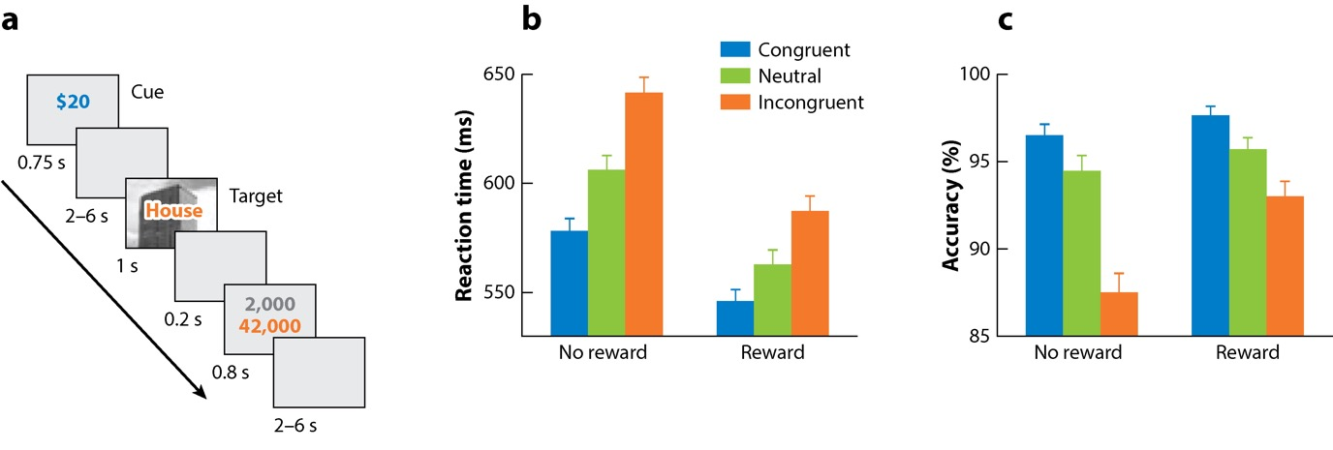
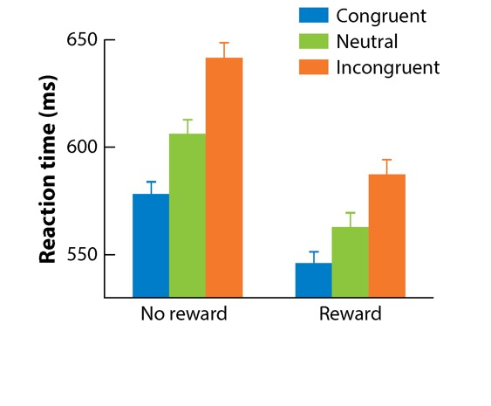
Background
Reward enhances cognitive control.
Botvinick & Braver, Annual Rev., 2015
Adapted from Padmala & Pessoa, JCogNeuro, 2001

